Slide 1
Day 6

Slide 2
Today’s agenda
Day | Topic | Chapter Details | Time Duration
Day 6 | the CASE | Basic CASE statements | 60 mins
 |  | CASE statements comparing column values
 |  | CASE statements comparing two column values part 2
 |  | Filtering your CASE statement
 |  | CASE WHEN with aggregate functions
 |  | COUNT using CASE WHEN
 |  | COUNT and CASE WHEN with multiple conditions
 |  | Calculating percent with CASE and AVG
 | 5 mins Break
 | dates and timestamps | Date/time types and formats | 60 mins
 |  | Date arithmetic
 |  | Completion time by category
 |  | Date/time components and aggregation
 |  | Variation by day of week
 |  | Date truncation
 |  | Aggregating with date/time series
 |  | Find missing dates
 |  | Custom aggregation periods

Slide 3
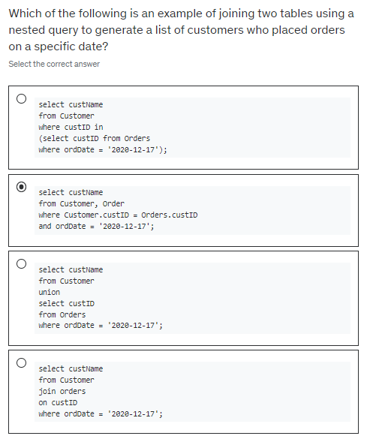

Slide 4
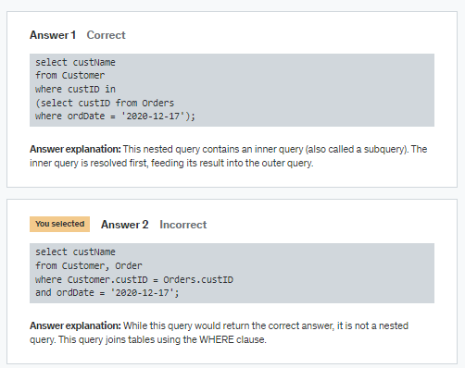

Slide 5
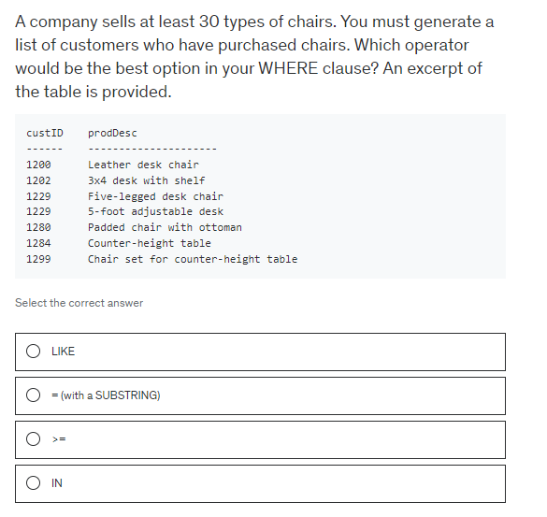

Slide 6
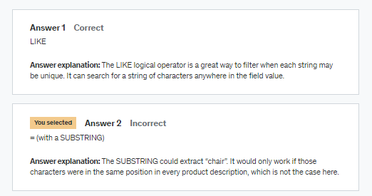

Slide 7
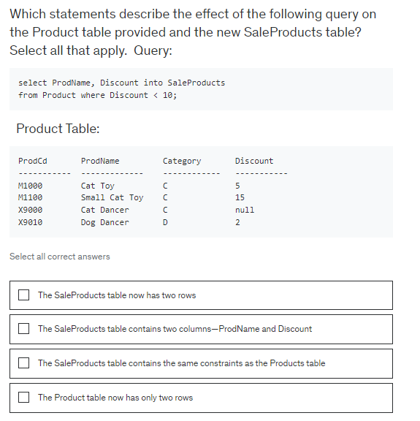

Slide 8
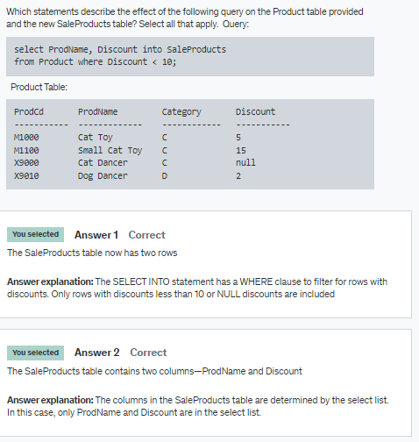

Slide 9
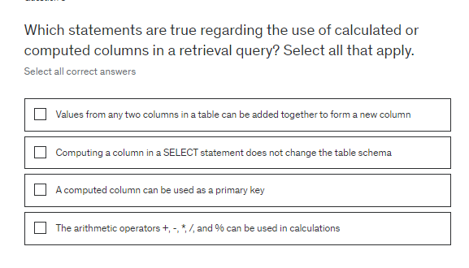

Slide 10
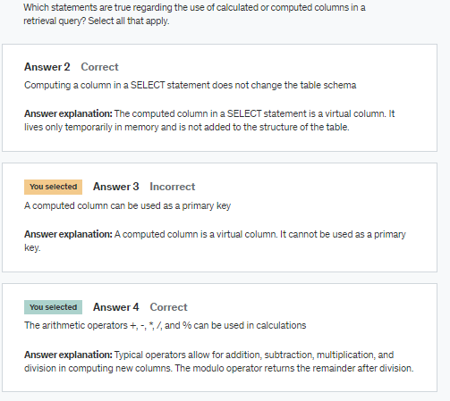

Slide 11
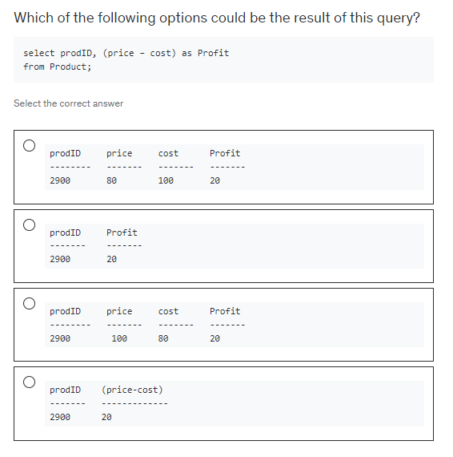

Slide 12
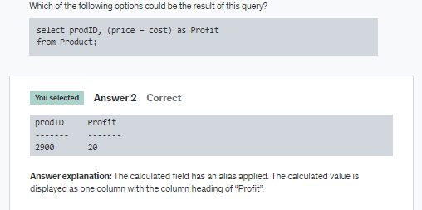

Slide 13
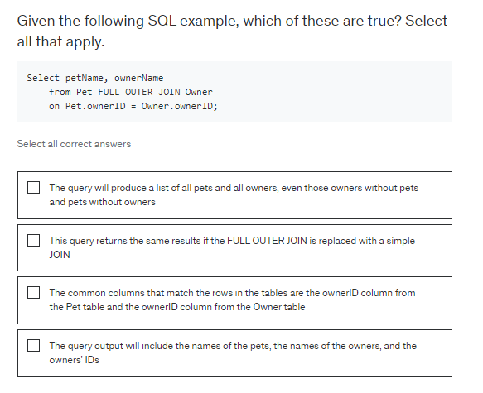

Slide 14
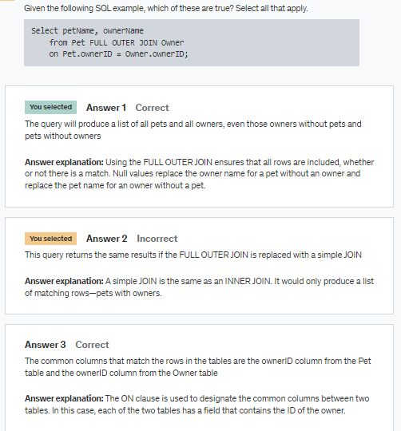

Slide 15
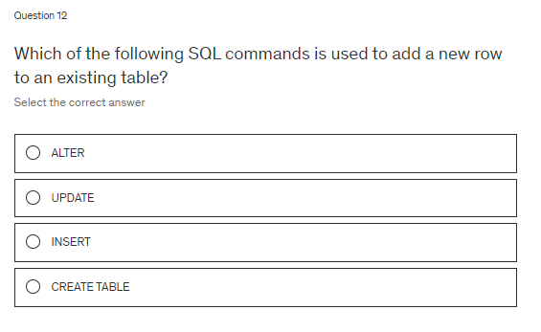

Slide 16
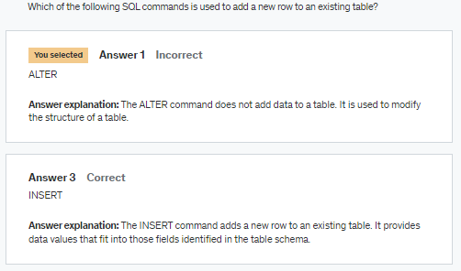

Slide 17
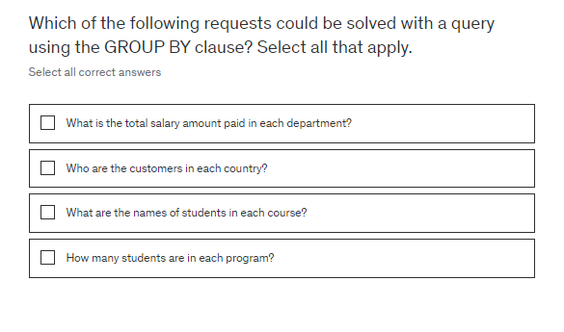

Slide 18
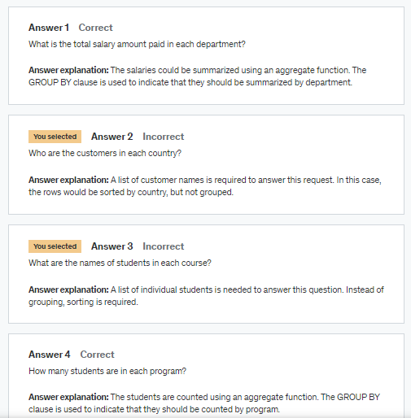

Slide 19
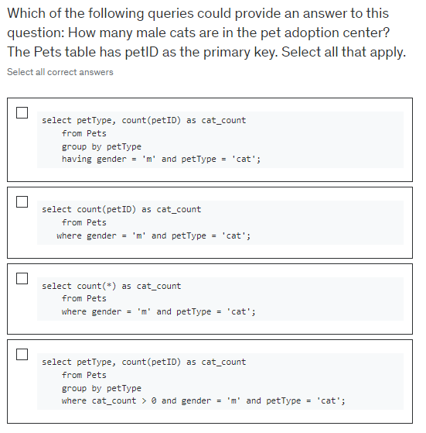

Slide 20
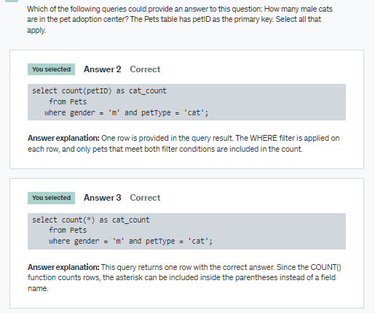

Slide 21
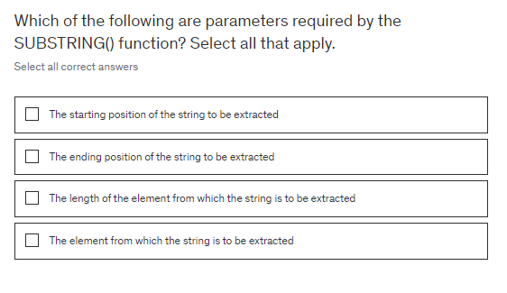

Slide 22
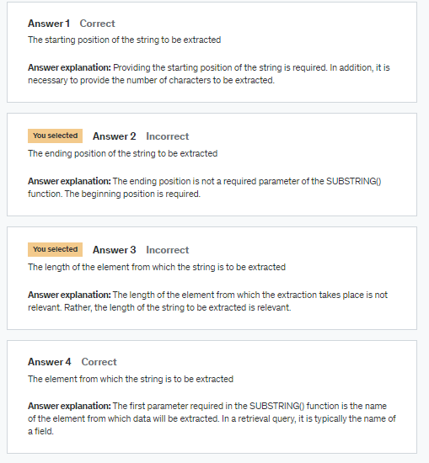

Slide 23
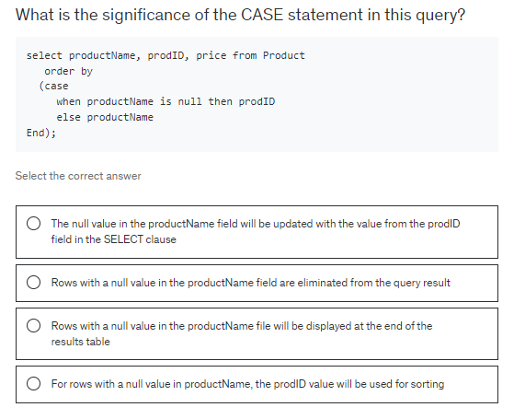

Slide 24
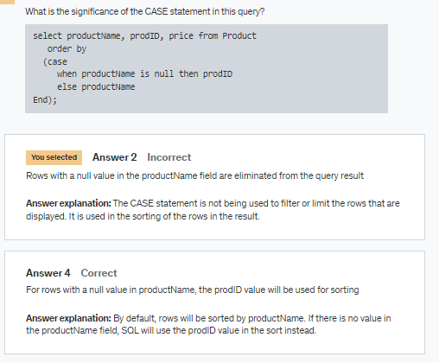

Slide 25
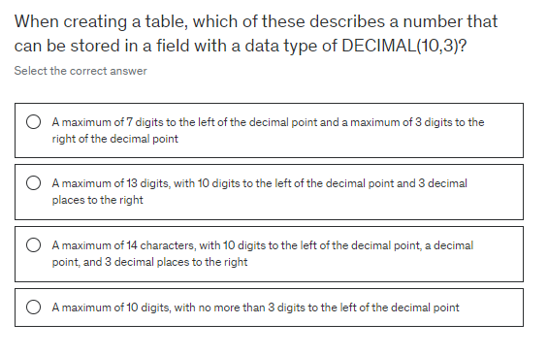

Slide 26
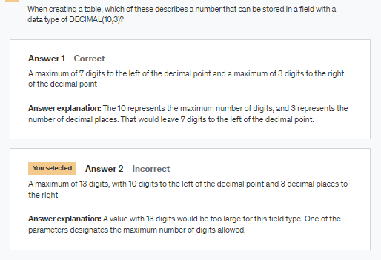

Slide 27
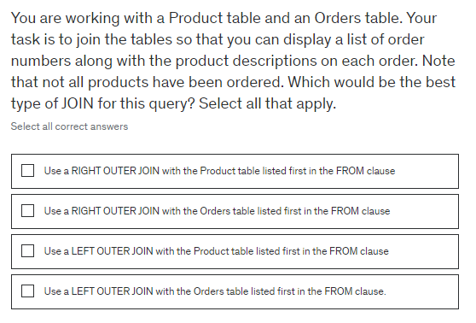

Slide 28
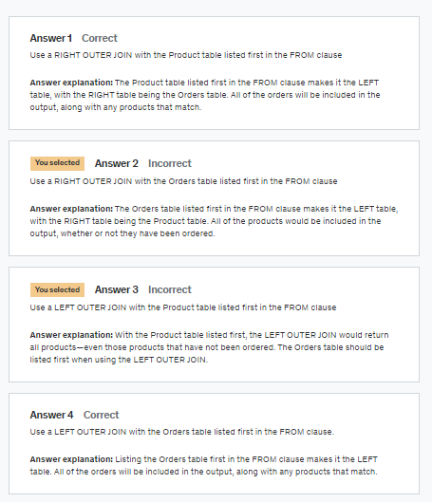

Slide 29
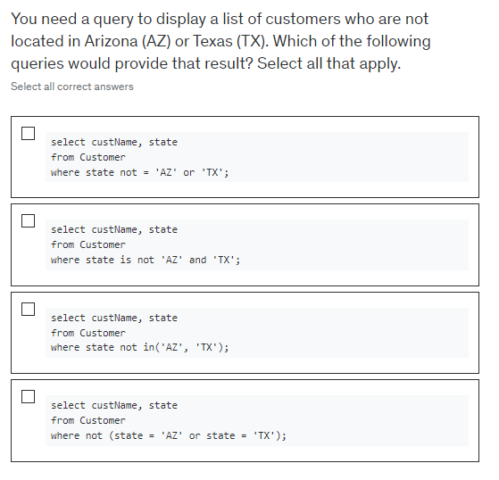

Slide 30
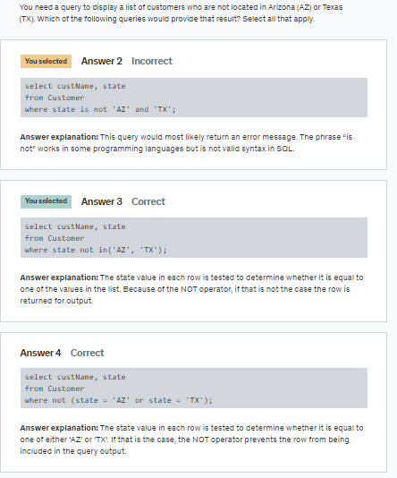

Slide 31
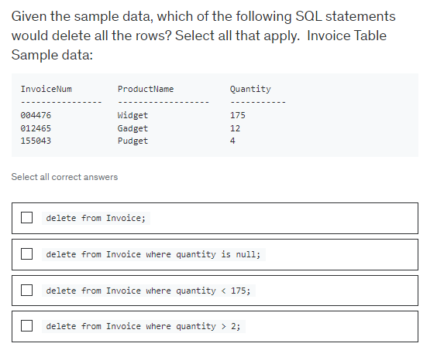

Slide 32
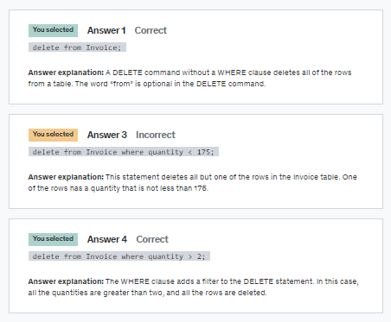

Slide 33
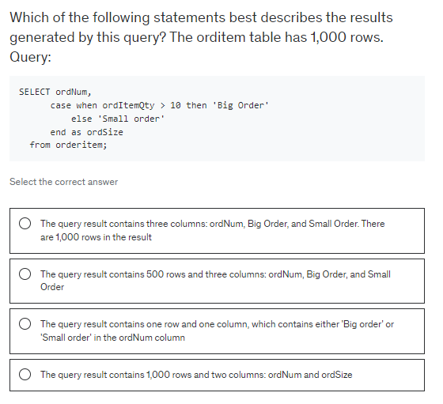

Slide 34
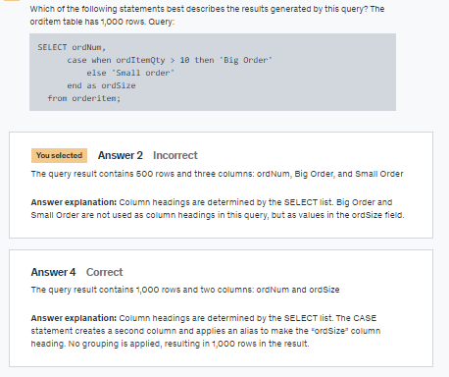

Slide 35


Slide 36
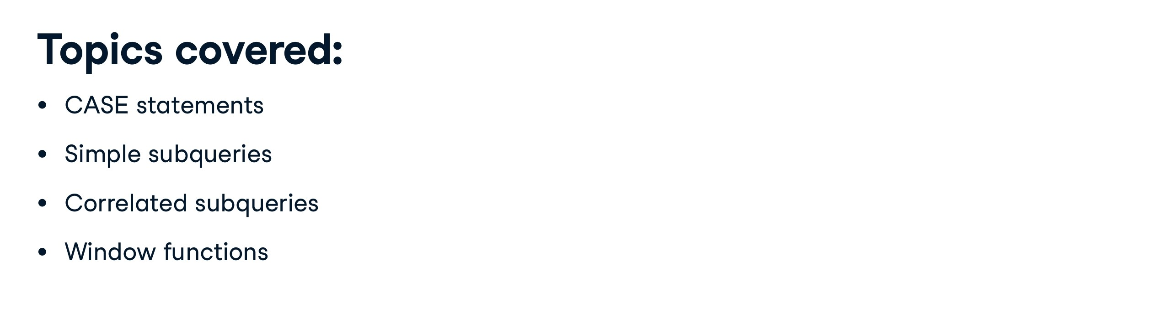

Slide 37
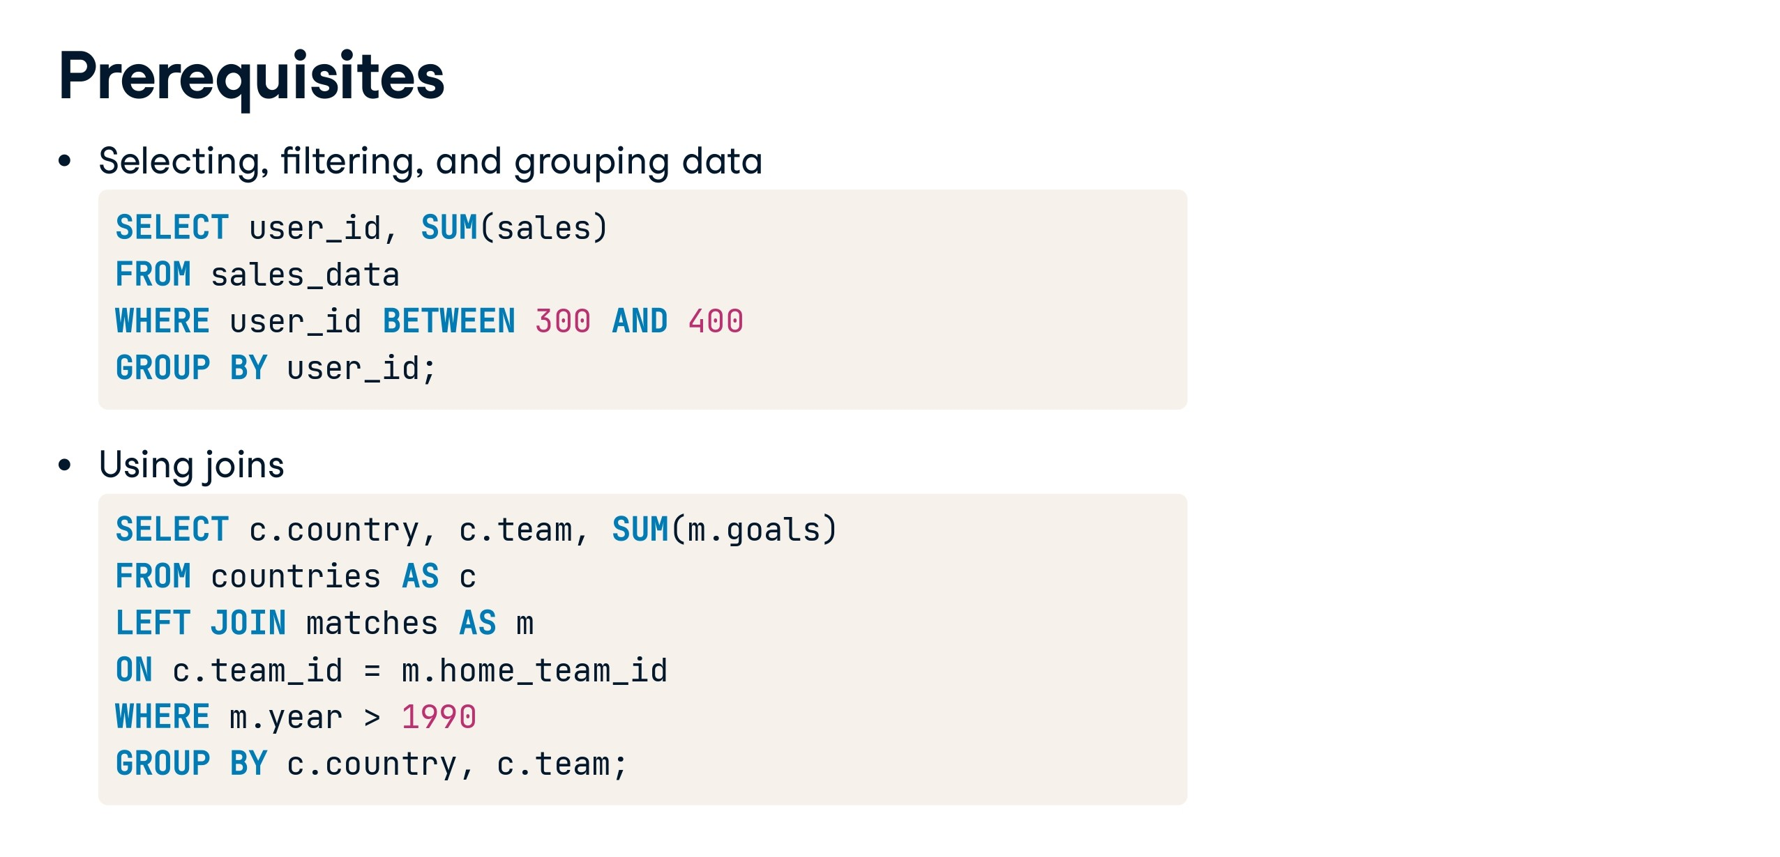

Slide 38
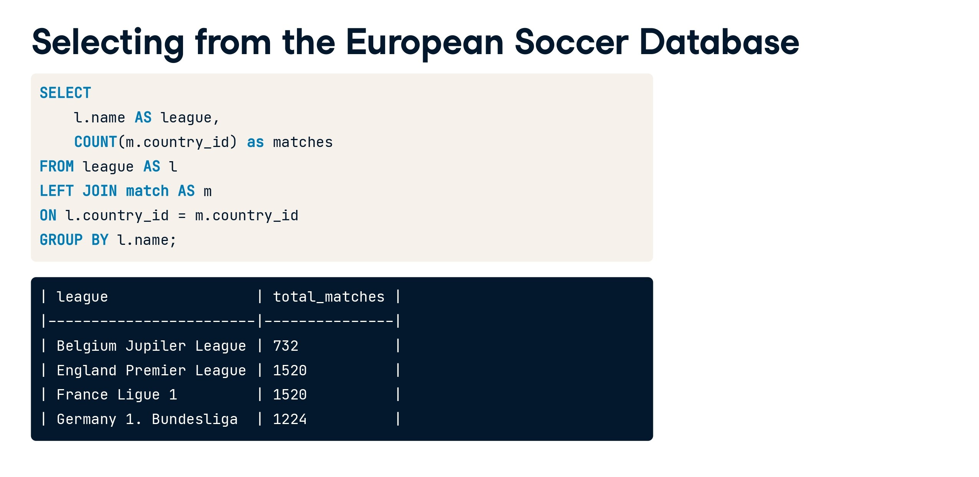

Slide 39
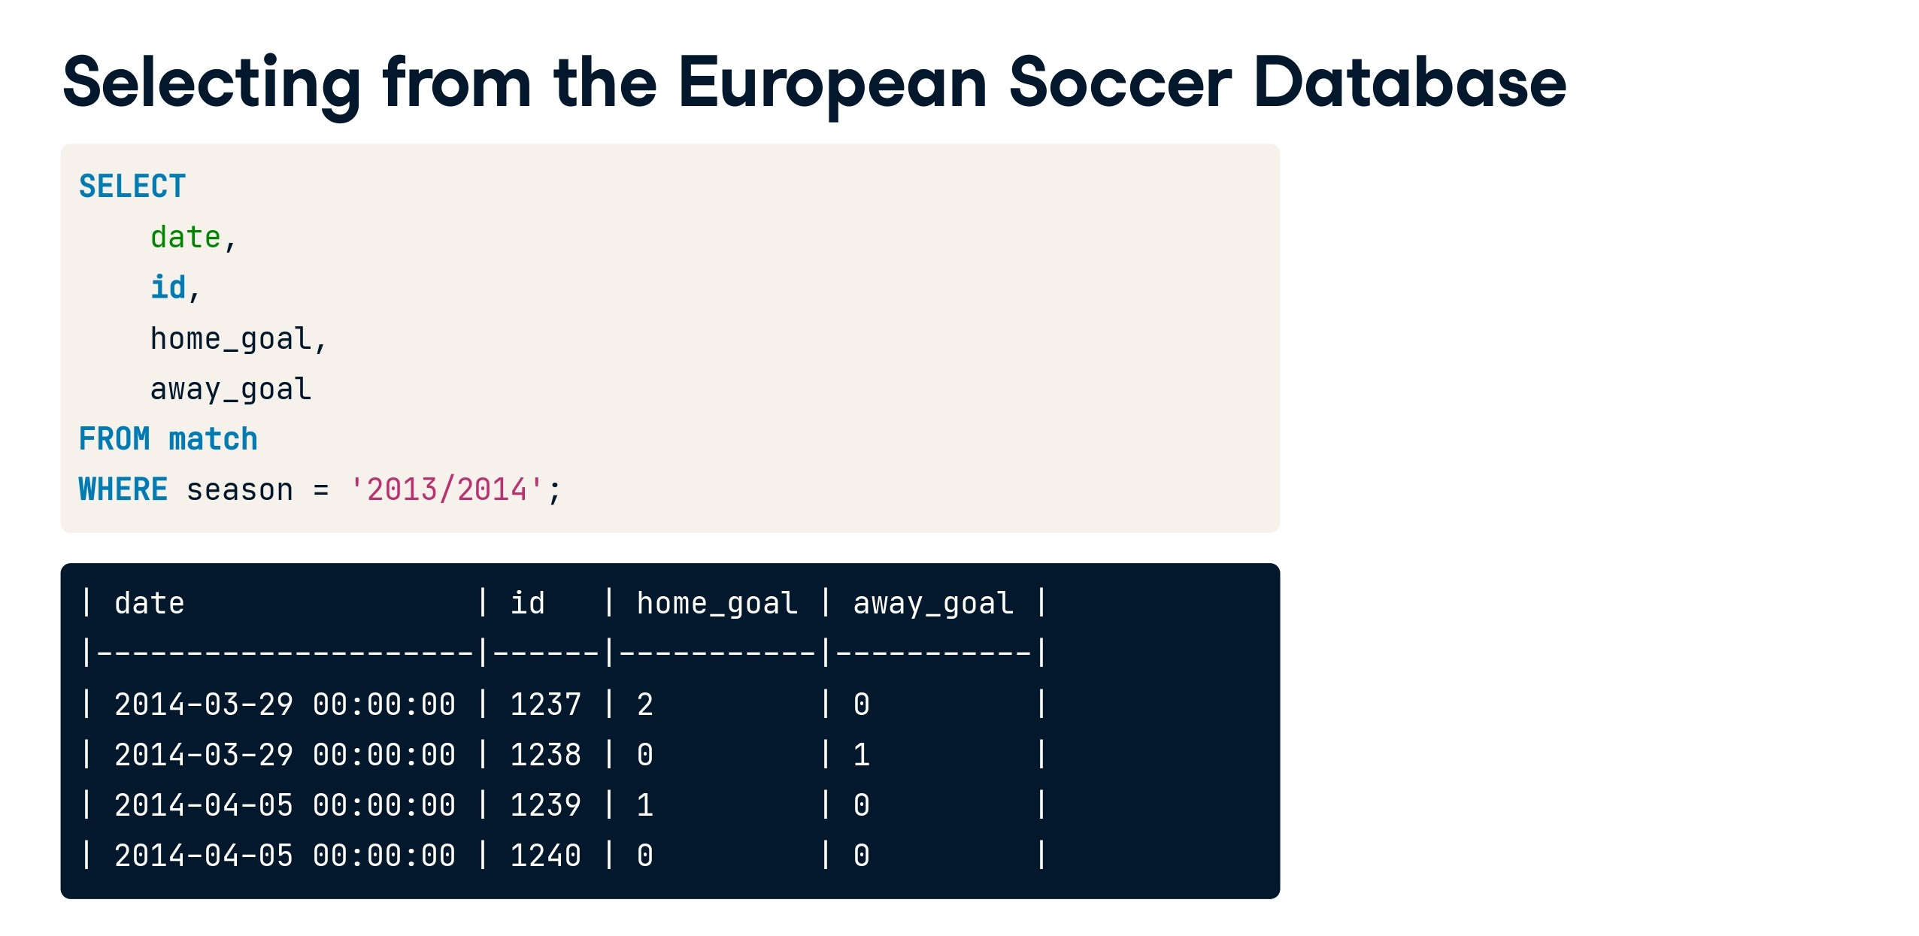

Slide 40
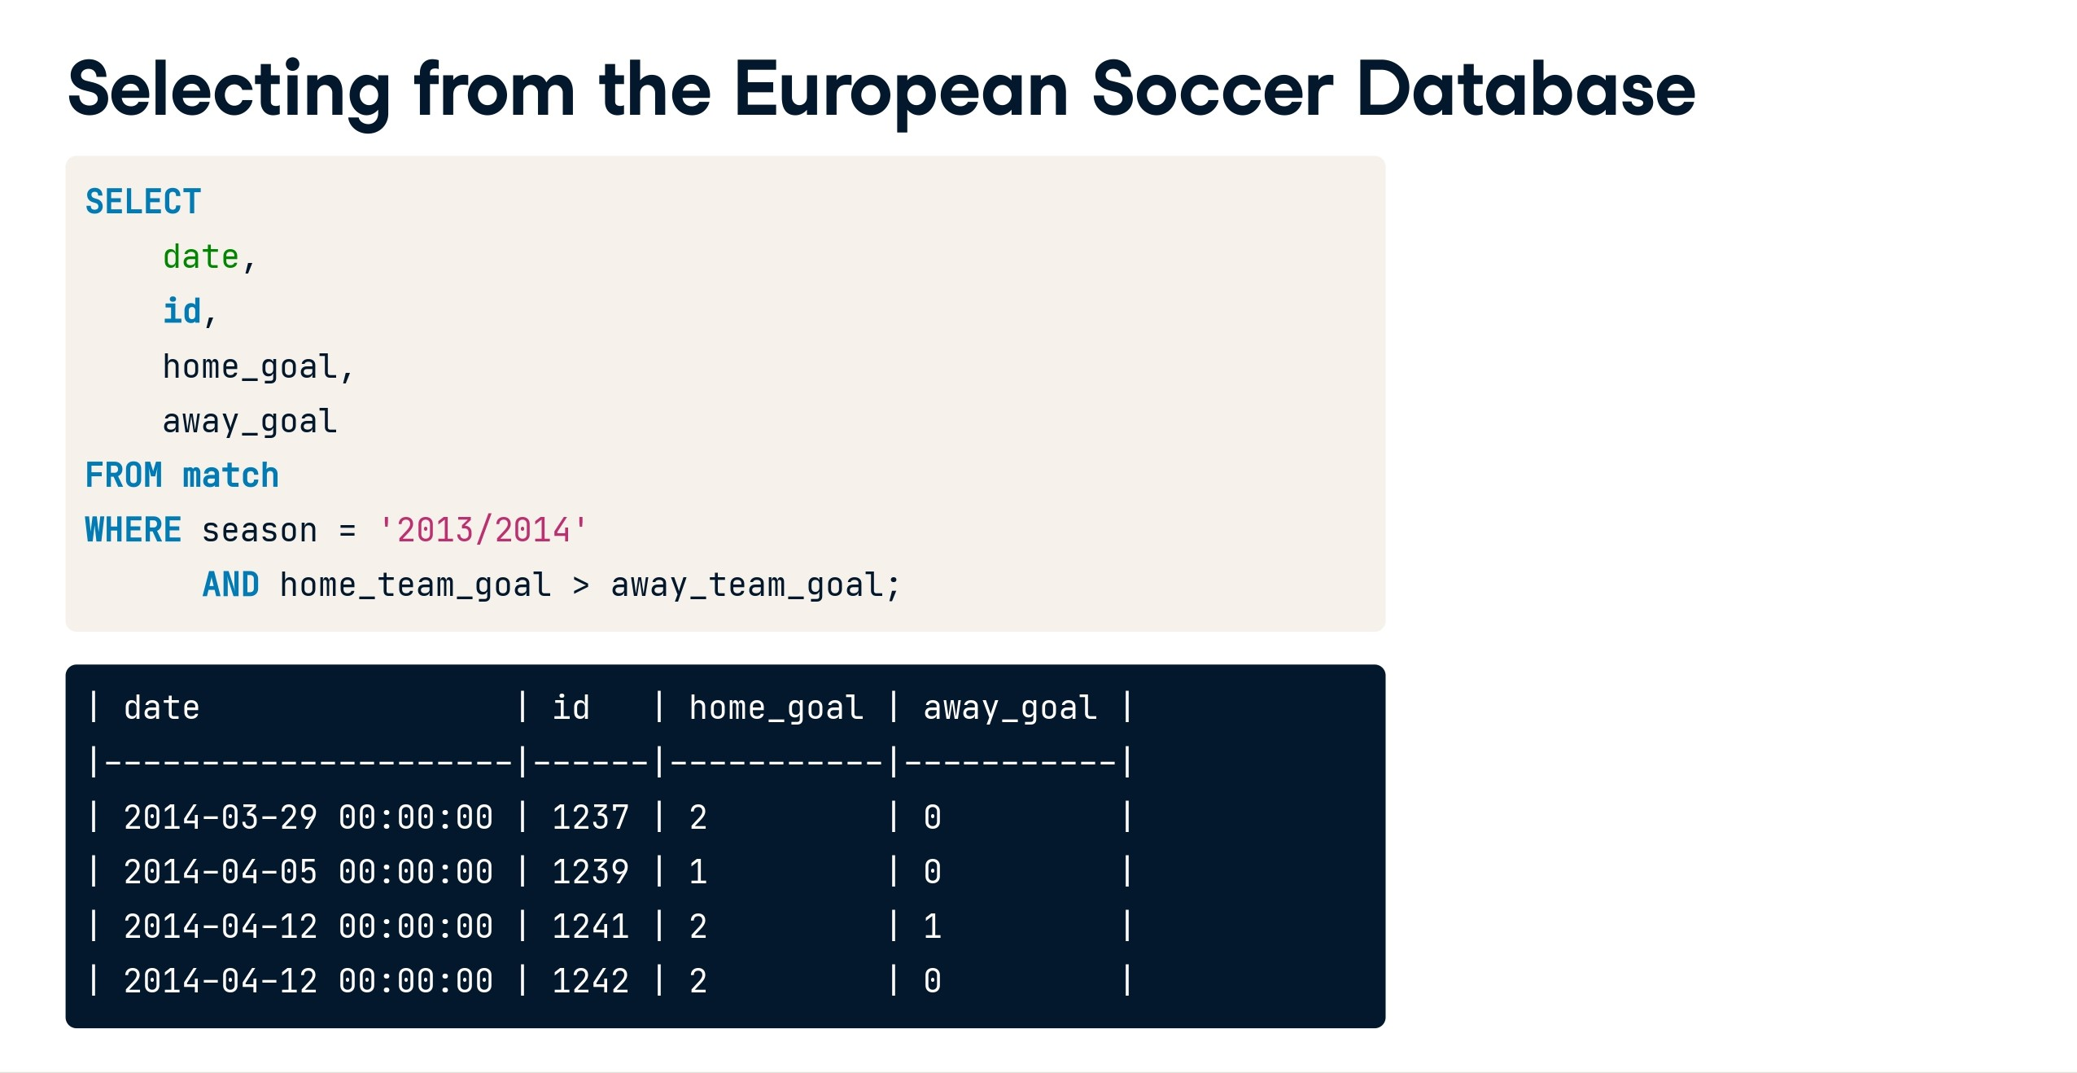

Slide 41
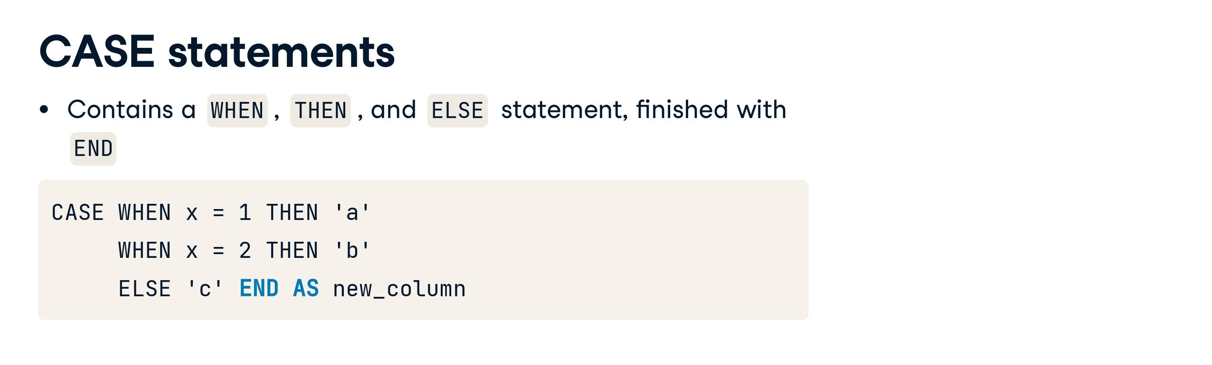

Slide 42
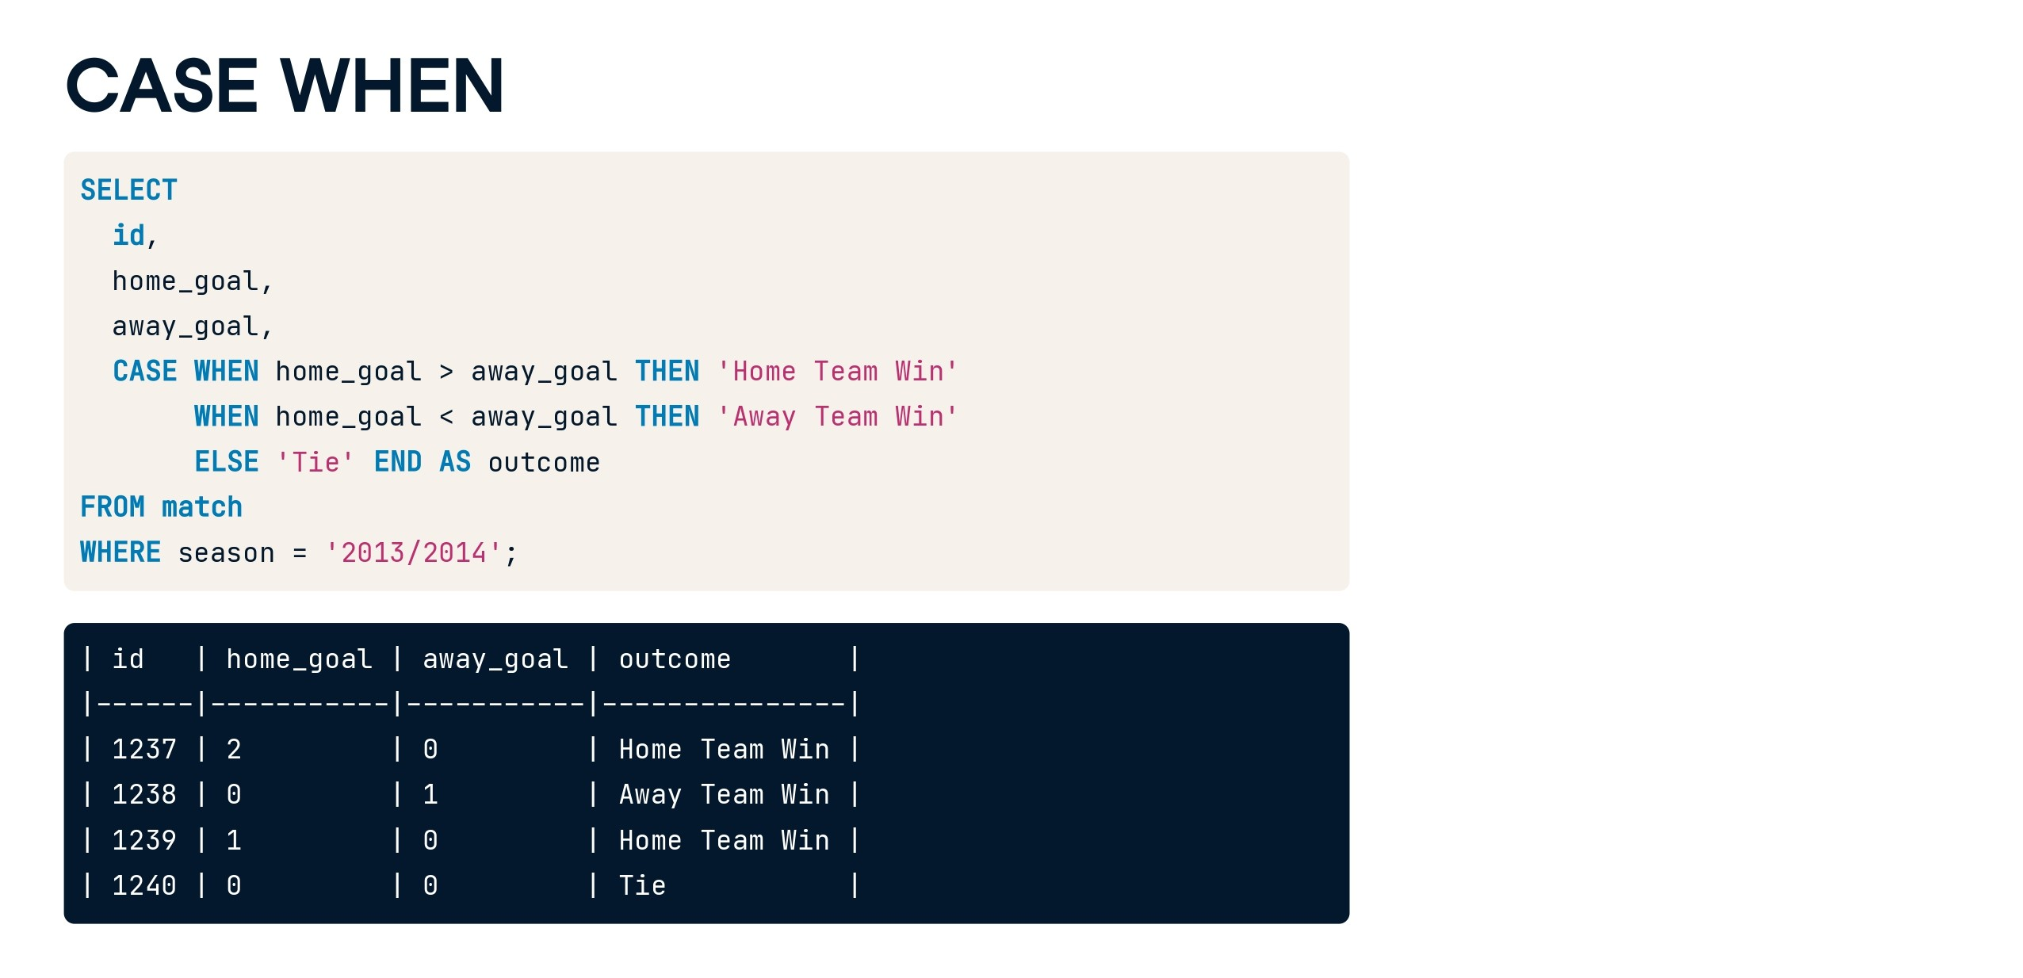

Slide 43


Slide 44
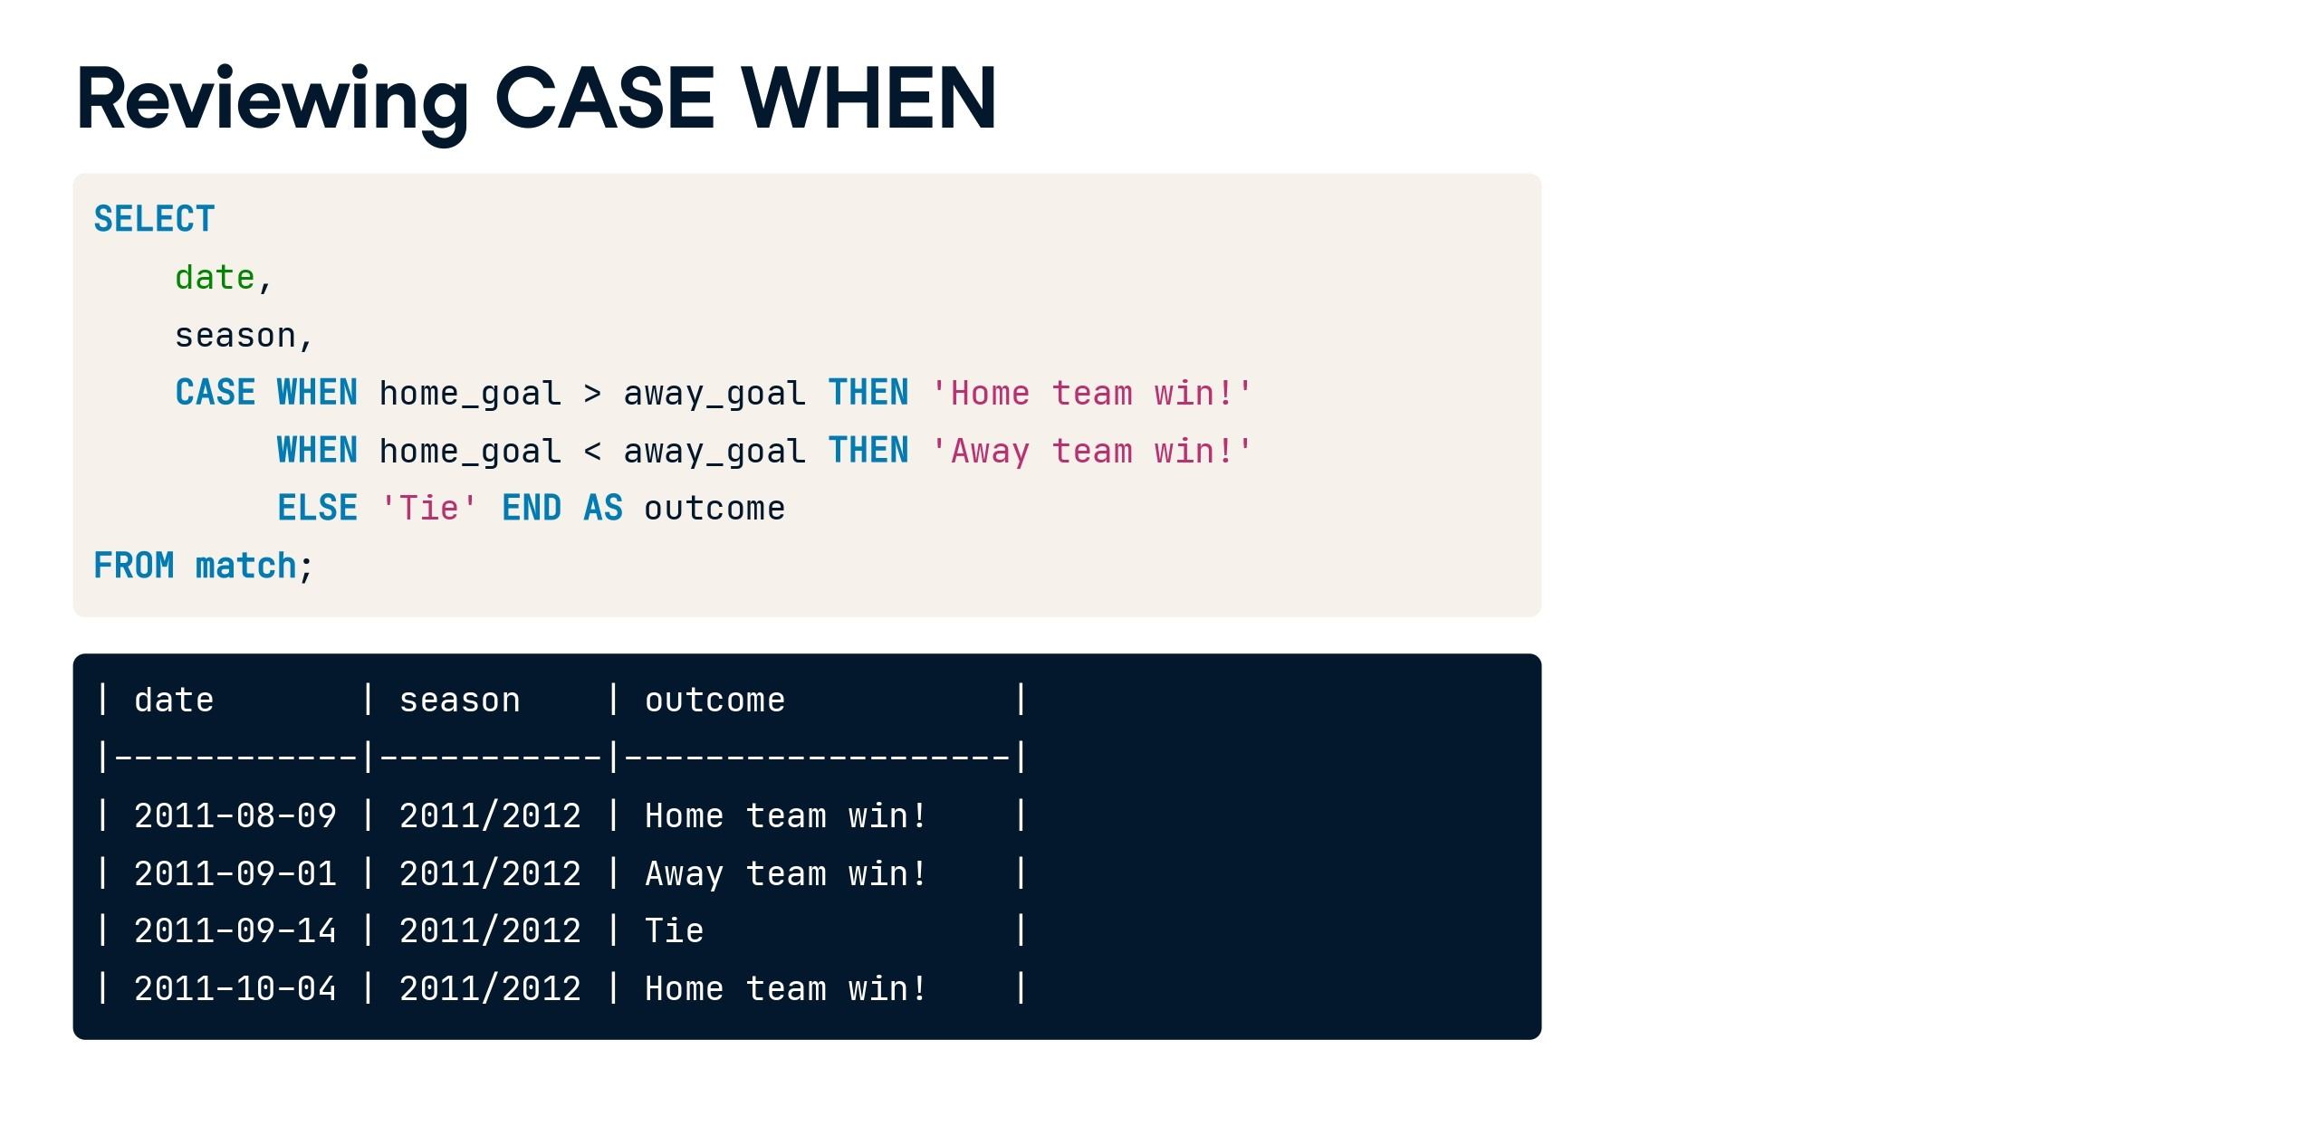

Slide 45
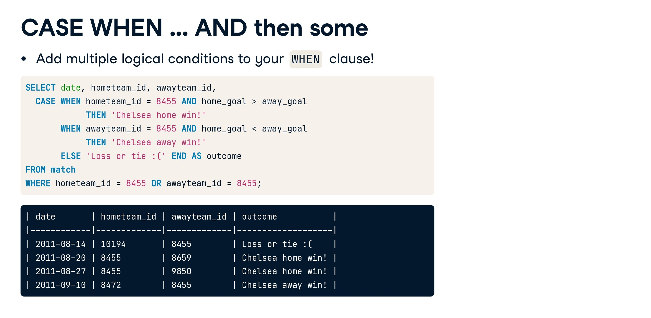

Slide 46
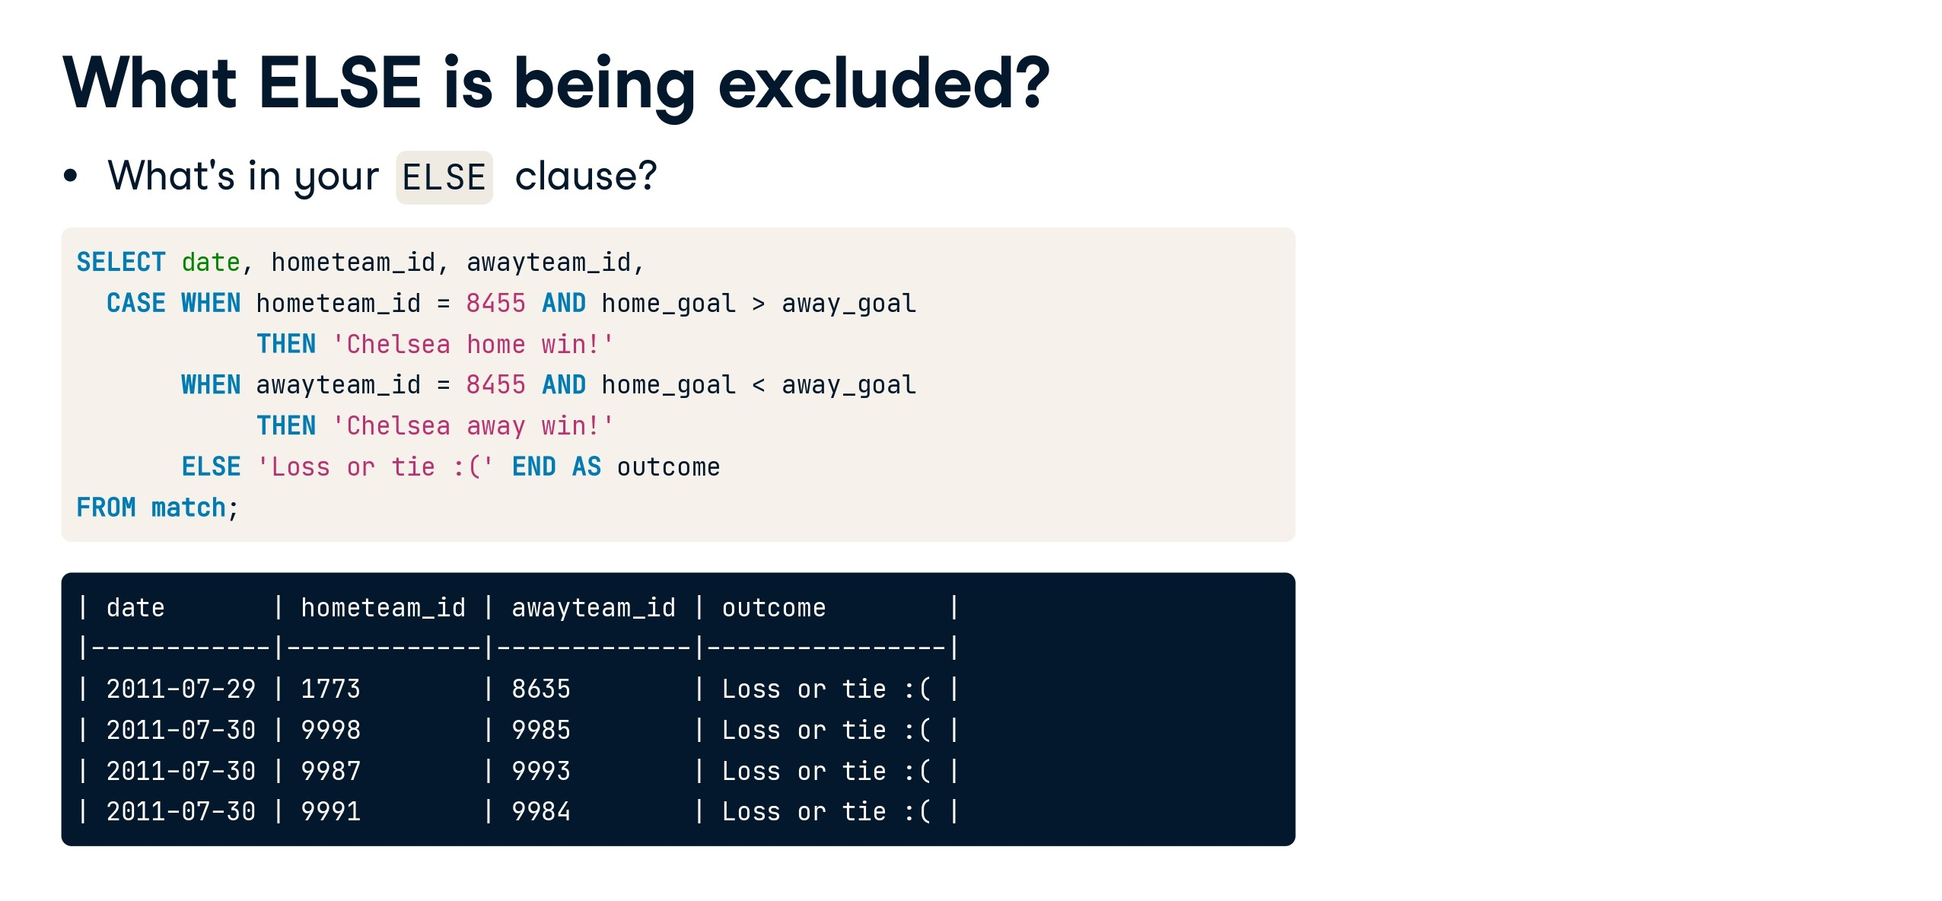

Slide 47
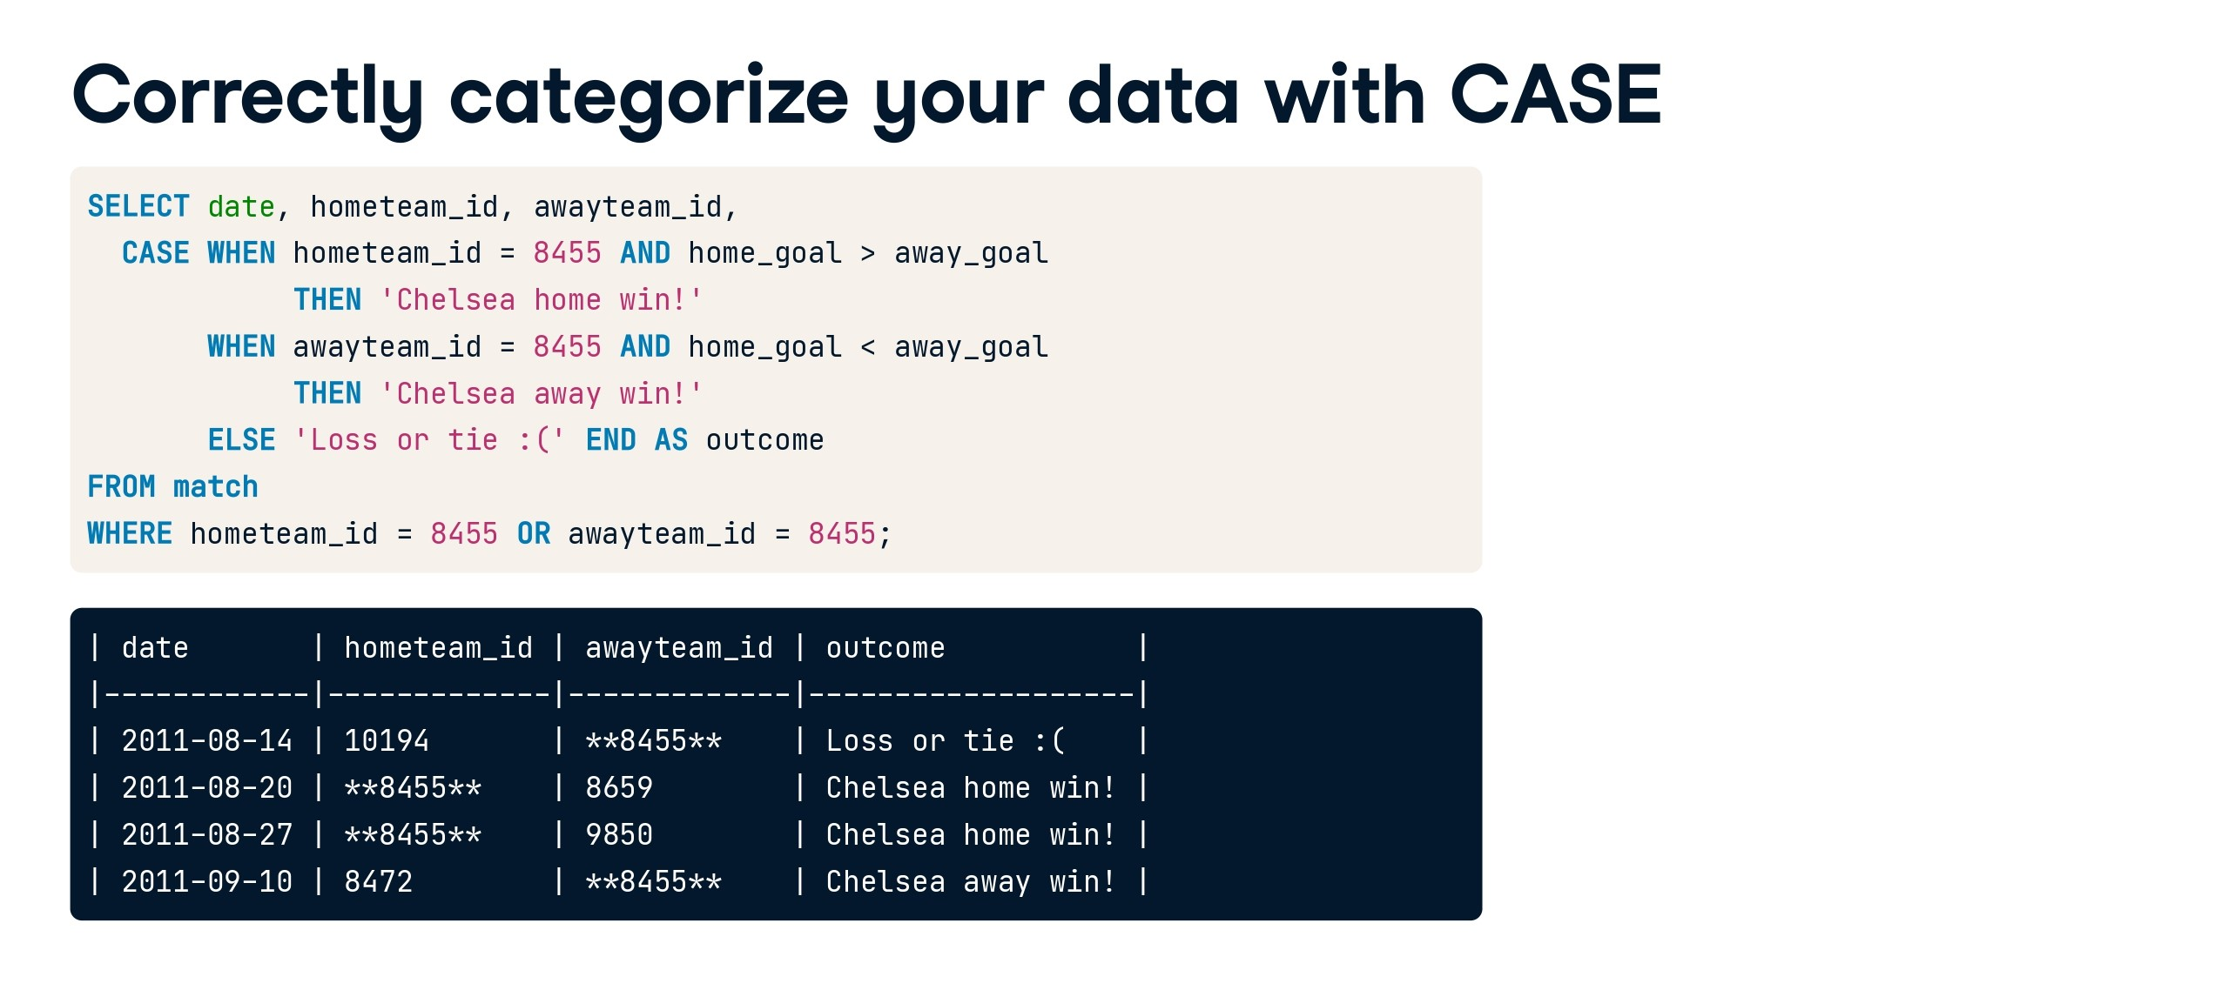

Slide 48
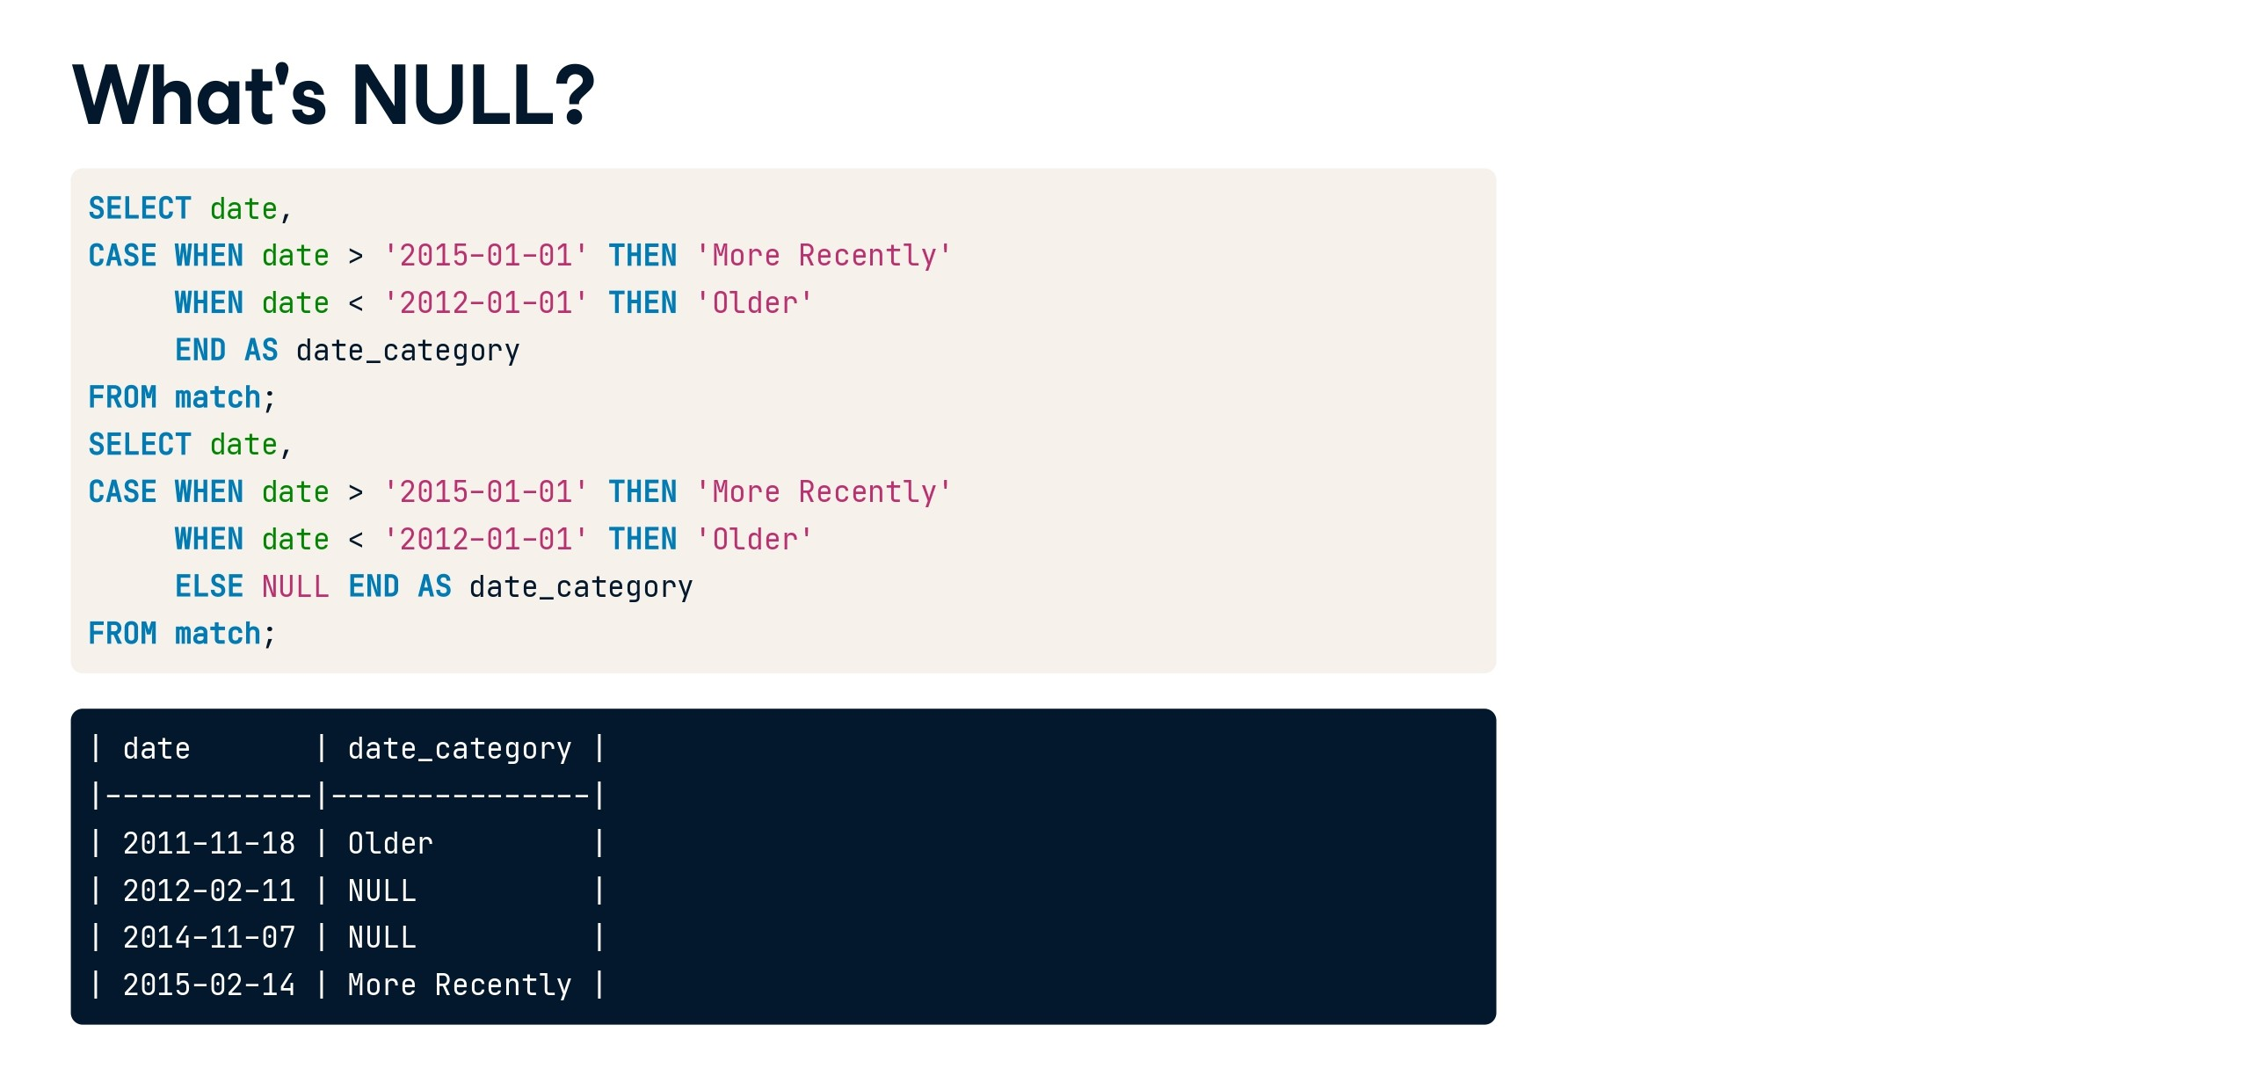

Slide 49
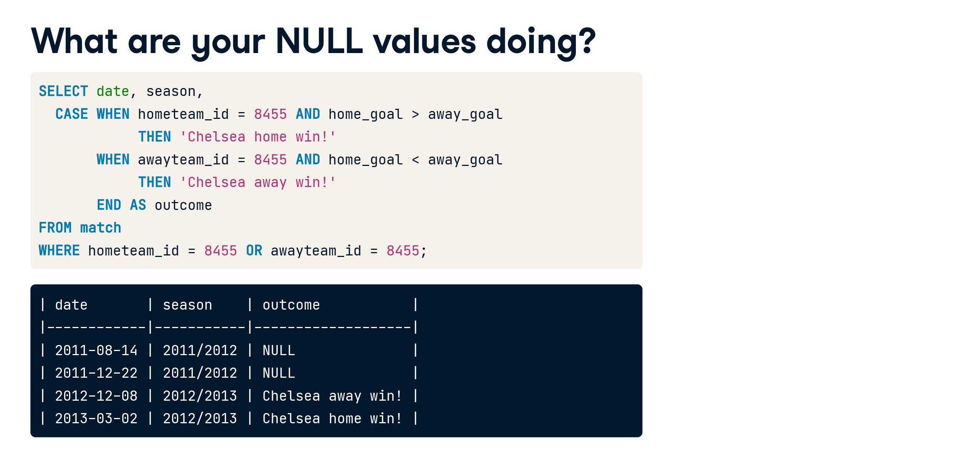

Slide 50
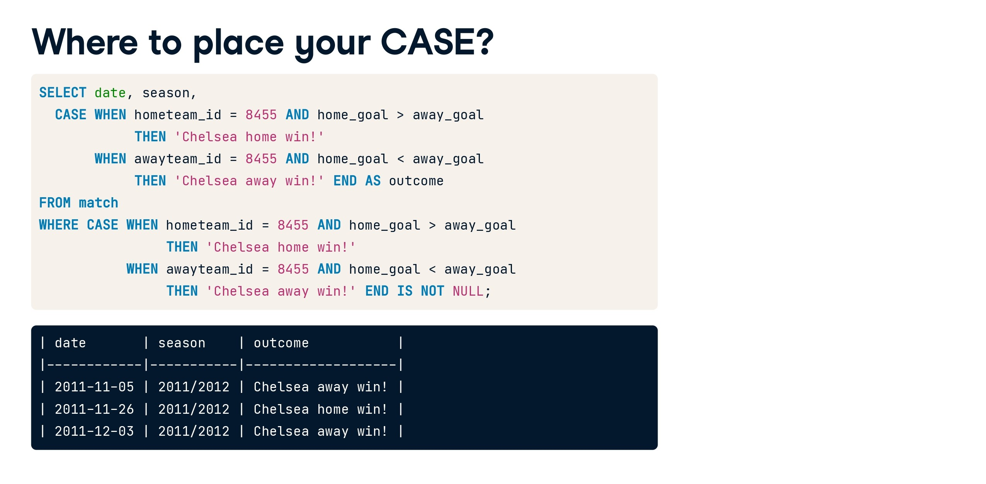

Slide 51


Slide 52
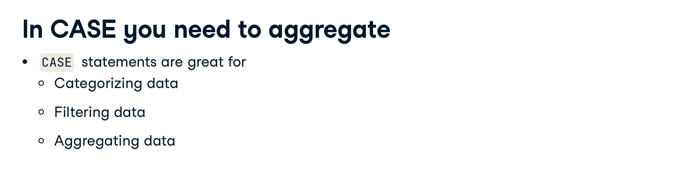

Slide 53
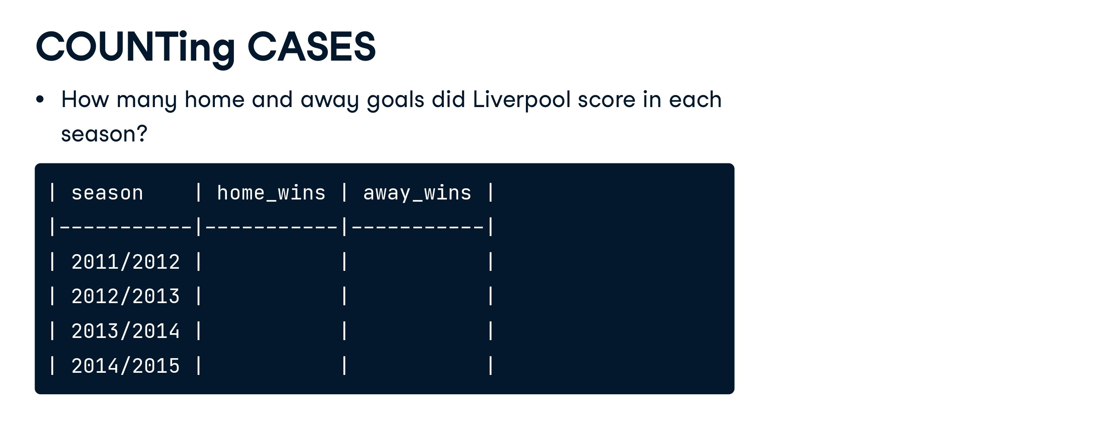

Slide 54
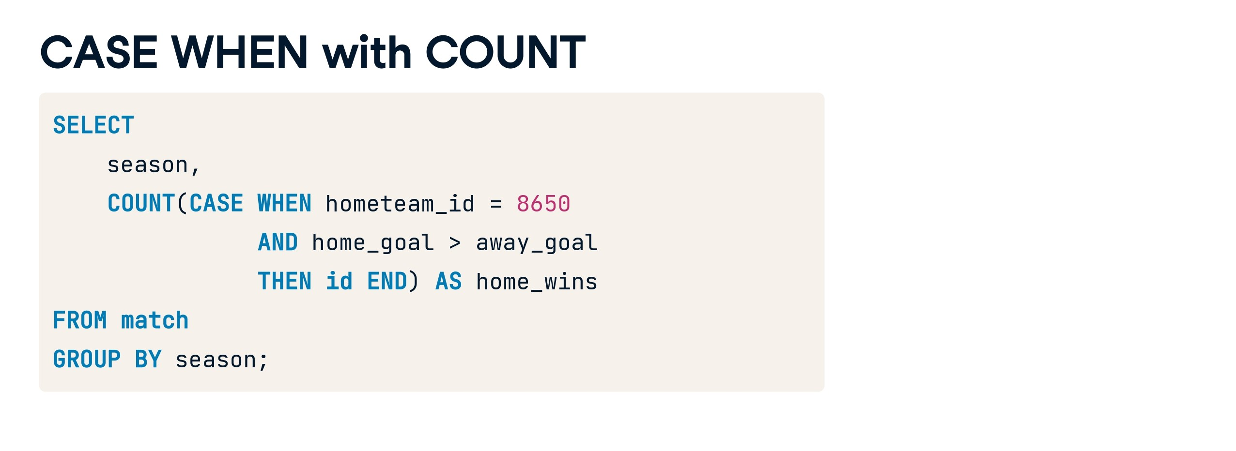

Slide 55
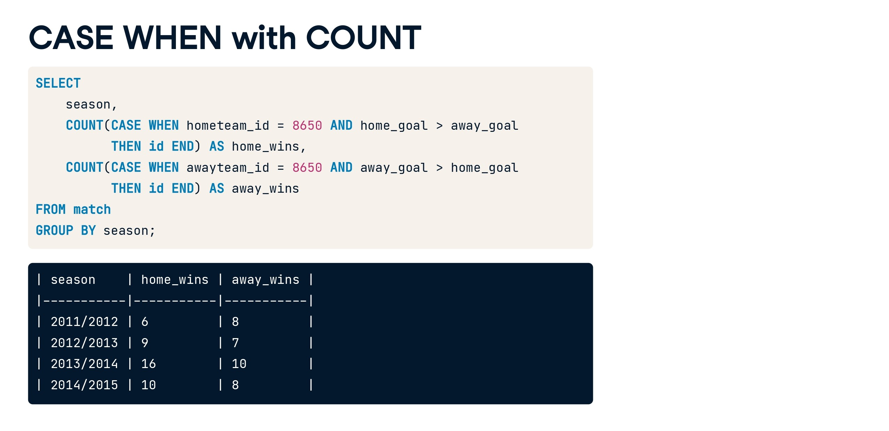

Slide 56


Slide 57


Slide 58


Slide 59


Slide 60


Slide 61


Slide 62


Slide 63


Slide 64
SELECT CURRENT_TIMESTAMP;
SELECT getdate();
SELECT sysdatetime();
SELECT SYSDATETIMEOFFSET();
CURRENT_TIMESTAMP:
CURRENT_TIMESTAMP is an ANSI SQL standard way to obtain the current date and time.
It can be used in SQL Server as well as in many other database systems.
The precision of the timestamp may vary depending on the specific database system, but it typically includes seconds.
getdate():
getdate() is specific to Microsoft SQL Server.
It also retrieves the current date and time but includes milliseconds for higher precision.

Slide 65
SELECT CustomerID, datename(month,Starttime) AS Extractmonth
FROM CallCenter;
SELECT CustomerID,eomonth(Starttime) AS Extractmonth
FROM CallCenter;
SELECT ProductID, SellStartDate,datepart(month,sellstartdate) AS Extractmonth
FROM Production.Product;
SELECT ProductID, SellStartDate,day(sellstartdate) AS ExtractDay
FROM Production.Product;
SELECT ProductID, SellStartDate,month(sellstartdate) AS ExtractMonth
FROM Production.Product;
SELECT ProductID, SellStartDate,year(sellstartdate) AS ExtractYear
FROM Production.Product;

Slide 66
SELECT ProductID, SellStartDate,dateadd(yyyy,3,sellstartdate) AS NewSellStartDate
FROM Production.Product;
SELECT ProductID, SellStartDate,dateadd(q,3,sellstartdate) AS NewSellStartDate
FROM Production.Product;
SELECT ProductID, SellStartDate,dateadd(m,3,sellstartdate) AS NewSellStartDate
FROM Production.Product;
SELECT ProductID, SellStartDate,dateadd(d,3,sellstartdate) AS NewSellStartDate
FROM Production.Product;
SELECT ProductID, SellStartDate,dateadd(hh,3,sellstartdate) AS NewSellStartDate
FROM Production.Product;
SELECT ProductID, SellStartDate,dateadd(n,50,sellstartdate) AS NewSellStartDate
FROM Production.Product;
SELECT ProductID, SellStartDate,dateadd(s,10,sellstartdate) AS NewSellStartDate
FROM Production.Product;
SELECT ProductID, SellStartDate,SellEndDate, dateadd(ms,50,sellstartdate) AS NewSellStartDate
FROM Production.Product;
SELECT ProductID, SellStartDate,SellEndDate, dateadd(m,50,sellstartdate) AS NewSellStartDate
FROM Production.Product;
SELECT ProductID, SellStartDate,SellEndDate, datediff(yyyy,sellstartdate,sellenddate) AS diffDate
FROM Production.Product;
SELECT ProductID, SellStartDate,SellEndDate, datediff(q,sellstartdate,sellenddate) AS diffDate
FROM Production.Product;
SELECT ProductID, SellStartDate,SellEndDate, datediff(q,sellstartdate,sellenddate) AS diffDate
FROM Production.Product
WHERE SellEndDate IS NOT NULL;

Slide 67


Slide 68


Slide 69


Slide 70


Slide 71


Slide 72
Views
-- Create a view for the CallCenter table
CREATE VIEW vwCallCenter AS
SELECT
CallID,
CustomerID,
AgentID,
StartTime,
EndTime,
CallDuration,
CallStatus,
Notes
FROM CallCenter;
-- Create a view for the Customer table
CREATE VIEW vwCustomer AS
SELECT
CustomerID,
FirstName,
LastName,
PhoneNumber,
Email
FROM Customer;
-- Create a view for the Agent table
CREATE VIEW vwAgent AS
SELECT
AgentID,
FirstName,
LastName,
Department,
Email
FROM Agent;
c
-- Example query using the vwCustomer view
SELECT * FROM vwCustomer;
-- Example query using the vwAgent view
SELECT * FROM vwAgent;

Slide 73
Update table
UPDATE CallCenter
SET
CallStatus = 'Completed',
Notes = 'Updated notes
for this call.'
WHERE
CallID > 10;
UPDATE TableName
SET Column1 = NewValue1, Column2 = NewValue2, ...
WHERE Condition;
TableName is the name of the table you want to update.
SET specifies which columns to update and their new values.
WHERE is an optional clause that specifies the condition to identify the rows to be updated. If omitted, all rows in the table will be updated.
Updating Specific Rows: You can use the WHERE clause to specify which rows should be updated based on a certain condition. For example, you can update rows where a specific column meets a certain criteria.
Updating Multiple Columns: You can update multiple columns in a single UPDATE statement by separating the column assignments with commas.
Updating with Subqueries: In more complex scenarios, you can use subqueries within the UPDATE statement to calculate new values based on other tables or conditions.
No Default Order: SQL does not guarantee a specific order for updating rows. If you need a specific order, you should use an appropriate ORDER BY clause within your subquery.

Slide 74
Dynamic coding in SQL
DECLARE @DynamicSQL VARCHAR(MAX)
SET @DynamicSQL = 'select top 3 * from Employees'
---SELECT @DynamicSQL
EXEC(@DynamicSQL)
-- Dynamic code
create function add_five(@num as int)
returns int
as
begin
return (@num + 5)
end
--calling of function
declare @result int
select @result=dbo.add_five(1086)
select @result as result

Slide 75
Delete in SQL
Delete all values only: delete from students1
Delete whole table permanently:
DROP TABLE table_name;

Slide 76
You are given a table named TriangleSides with the following structure:
A: Length of side A (integer)
B: Length of side B (integer)
C: Length of side C (integer)
You need to write a SQL query to determine whether each set of sides (A, B, C) forms a valid triangle or not, based on the triangle inequality theorem.

Slide 77
CREATE TABLE TriangleSides1 (
A INT,
B INT,
C INT
);
INSERT INTO TriangleSides1 (A, B, C) VALUES
(20, 10, 35),
(30, 25, 21),
(21, 22, 20);
SELECT
A, B, C,
CASE
WHEN A + B > C AND A + C > B AND B + C > A THEN 'Triangle'
ELSE 'Not a Triangle'
END AS triangle_check
FROM
TriangleSides1;

Slide 78
select * from trianglesides
select
case
when a+b>c and a+c>b and b+c>a then
------------------------
case
when a=b and b=c then 'Equilateral'
when a=b or b=c or a=c then 'Isoceles'
else 'Not Isoceles'
end
-------------------------
else 'Not a triangle'
end
from trianglesides

Slide 79
-- find total num of each student in class also determine grades
-- 60/100 'D'
-- 70/100 'C'
-- 80/100 'B'
-- 90/100 'A'
-- 100/100 'A+'

Slide 80
SELECT *,
CASE WHEN years_of_exp > 8 THEN 'Exp greater than 8'
WHEN years_of_exp < 8 THEN 'Exp less than 8'
ELSE 'Tie' END AS outcome
FROM Employees1;

Slide 81
SELECT *,
CASE
WHEN ratings >= 3.5 AND price >= 50000 THEN 1
WHEN ratings >= 3.0 AND price >= 30000 THEN 2 ELSE 0
END AS outcome
FROM laptop;

Slide 82
SELECT
SUM(CASE WHEN active_on_website = 1 THEN price ELSE 0 END) AS total_active_price,
SUM(CASE WHEN active_on_website = 0 THEN price ELSE 0 END) AS total_inactive_price
FROM laptop;
------------------------------------
select sum (price)
from laptop
where active_on_website=1

Slide 83
SELECT
AVG(CASE WHEN active_on_website = 1 THEN price ELSE NULL END)
AS average_price_active,
AVG(CASE WHEN active_on_website = 0 THEN price ELSE NULL END)
AS average_price_active
FROM
laptop;

Slide 84
SELECT
round(AVG(CASE WHEN active_on_website = 1 THEN ratings ELSE NULL END),2)
AS average_price_active,
round(AVG(CASE WHEN active_on_website = 0 THEN ratings ELSE NULL END),2)
AS average_price_active
FROM
laptop;

Slide 85
CREATE TABLE sales ( "customer_id" VARCHAR(1), "order_date" DATE, "product_id" INTEGER ); INSERT INTO sales ("customer_id", "order_date", "product_id") VALUES ('A', '2021-01-01', '1'), ('A', '2021-01-01', '2'), ('A', '2021-01-07', '2'), ('A', '2021-01-10', '3'), ('A', '2021-01-11', '3'), ('A', '2021-01-11', '3'), ('B', '2021-01-01', '2'), ('B', '2021-01-02', '2'), ('B', '2021-01-04', '1'), ('B', '2021-01-11', '1'), ('B', '2021-01-16', '3'), ('B', '2021-02-01', '3'), ('C', '2021-01-01', '3'), ('C', '2021-01-01', '3'), ('C', '2021-01-07', '3'); CREATE TABLE menu ( "product_id" INTEGER, "product_name" VARCHAR(5), "price" INTEGER ); INSERT INTO menu ("product_id", "product_name", "price") VALUES ('1', 'sushi', '10'), ('2', 'curry', '15'), ('3', 'ramen', '12'); CREATE TABLE members ( "customer_id" VARCHAR(1), "join_date" DATE ); INSERT INTO members ("customer_id", "join_date") VALUES ('A', '2021-01-07'), ('B', '2021-01-09');

Slide 86
https://github.com/sharkawy98/sql-case-studies/blob/main/case_study_1/A)%20Main%20Questions.md
SELECT
customer_id,
sum(price) as spent
FROM
sales s,
menu m
WHERE m.product_id = s.product_id
GROUP BY customer_id;

Slide 87
https://github.com/sharkawy98/sql-case-studies/blob/main/case_study_1/A)%20Main%20Questions.md
1. What is the total amount each customer spent at the restaurant?
SELECT
customer_id,
sum(price) as spent
FROM
sales s,
menu m
WHERE m.product_id = s.product_id
GROUP BY customer_id;

Slide 88
https://github.com/sharkawy98/sql-case-studies/blob/main/case_study_1/A)%20Main%20Questions.md
2. How many days has each customer visited the restaurant?
SELECT
customer_id,
count(DISTINCT order_date) as visits
FROM sales
GROUP BY customer_id;

Slide 89
Rank Example: 1
SELECT
emp_id,
years_of_exp,
salary,
RANK() OVER (ORDER BY years_of_exp DESC) AS exp_rank
FROM
Employees;

Slide 90
Rank Example: 2
WITH RankedEmployees AS (
SELECT
emp_id,
salary,
RANK() OVER (ORDER BY salary DESC) AS exp_rank
FROM
Employees
)
SELECT
emp_id,
salary,
exp_rank
FROM
RankedEmployees
WHERE
exp_rank = 1;

Slide 91
4. What is the most purchased item on the menu and how many times was it
purchased by all customers?
SELECT
top(1)
product_name,
count(s.product_id) as purchased
FROM
sales s,
menu m
WHERE m.product_id = s.product_id
GROUP BY product_name
ORDER BY purchased DESC;

Slide 92
5. If each $1 spent equates to 10 points and sushi has a 2x points multiplier –
how many points would each customer have?
SELECT
customer_id,
sum(CASE
WHEN s.product_id = 1 THEN price*20
ELSE price*10
END) as total_points
FROM
sales s,
menu m
WHERE m.product_id = s.product_id
GROUP BY customer_id;

Slide 93
3. What was the first item from the menu purchased by each customer?
WITH cust_orders_cte AS(
SELECT
customer_id,
order_date,
product_name,
row_number() over (partition by customer_id
order by order_date) as rank
FROM
sales s,
menu m
WHERE m.product_id = s.product_id
)
SELECT
customer_id,
product_name
FROM cust_orders_cte
WHERE rank = 1;

Slide 94
SELECT CONVERT(VARCHAR, GETDATE(), 103) AS FormattedDateTime;

Slide 95
SELECT SYSDATETIME() AS current_datetime;

Slide 96
SELECT
date,
DATEPART(year, date) AS year_created,
DATEPART(month, date) AS month_created
FROM
stackexchange

Slide 97
SELECT
date,
DATEADD(day, 7, date) AS date_created_plus_7_days
FROM
stackexchange;

Slide 98
The `CONVERT` function in SQL Server allows you to format dates using various style codes. Here are some commonly used style codes for formatting dates:
- **101**: mm/dd/yyyy
- **102**: yyyy.mm.dd
- **103**: dd/mm/yyyy
- **104**: dd.mm.yyyy
- **105**: dd-mm-yyyy
- **106**: dd mon yyyy (e.g., 25 Nov 2021)
- **107**: Mon dd, yyyy (e.g., Nov 25, 2021)
- **108**: hh:mi:ss
- **109**: mon dd yyyy hh:mi:ss:mmmAM (or PM)
- **110**: mm-dd-yyyy
- **111**: yyyy/mm/dd
- **112**: yyyymmdd
- **113**: dd mon yyyy hh:mi:ss:mmm
- **114**: hh:mi:ss:mmm(24h)
- **120**: yyyy-mm-dd hh:mi:ss
- **121**: yyyy-mm-dd hh:mi:ss.mmm
- **126**: yyyy-mm-ddThh:mi:ss.mmmZ (ISO8601)
- **130**: dd mon yyyy hh:mi:ss:mmmAM
You can find the complete list of style codes and their corresponding formats in the Microsoft documentation: [CAST and CONVERT (Transact-SQL) - Date and Time Styles](https://docs.microsoft.com/en-us/sql/t-sql/functions/cast-and-convert-transact-sql?view=sql-server-ver15#date-and-time-styles)
When using the `CONVERT` function, you can choose the style code that matches the desired format for your output.

Slide 99
End of this day !!
Thanks

